Slide 1


Low temperature Combustion(LTC) in Diesel engines
Arjun Darbha
ME-EM

Slide 2
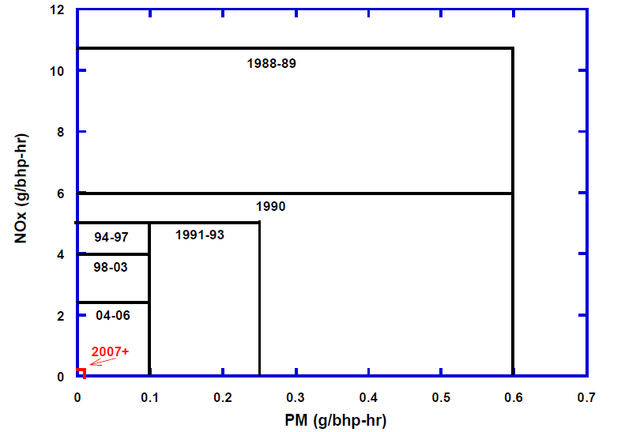
Motivation
Emissions – NOx, PM, UHC, CO
Emissions are a function of temperature
Low temperatures decrease
Nox at the cost of reduced
Efficiency
LTC strategies help to solve
this problem
Notes:
Model year 2007 and later Nox 0.20g/bhp-hr PM – 0.01 g/bhp-hr

Slide 3
Goals and objectives of this discussion
This discussion aims to provide information on different LTC strategies available and provide experimental proof by referring to results provided by reference papers
Objective of this work is to consolidate two different LTC strategies and recognize important variables that are controlled for employing these strategies
PPCI – LTC strategy discussed here has two categories
Early injection
Late injection (Modular kinetics)

Slide 4
Late injection (Modular Kinetics)
Fuel injected with a large ignition delay(ID) – very early into the expansion stroke
Nox reduces with lower O2 conc.
which is achieved by using higher EGR
resulting in UHC
To reduce UHC
IT is retarded
Swirl induced by changing combustion chamber design
Notes:
Three variables to be controlled, EGR, IT retard, swirl induction

Slide 5
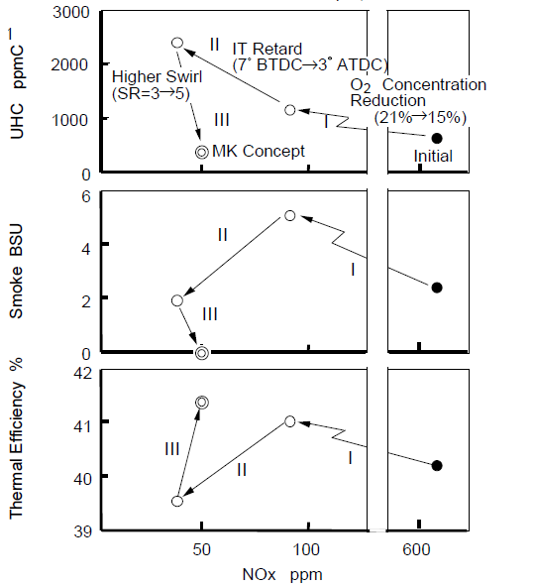
Late injection (Contd)

Slide 6
Early Injection PPCI
Single shot injection 60BTDC
Variables controlled during experimentation
EGR percentage
Injection pressure

Slide 7
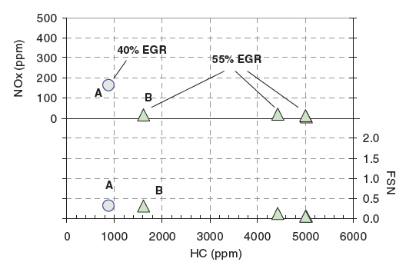
Early Injection PPCI
SOI (BTDC) | UHC (ppm) | NOx(ppm)
11 | 5000 | Below 15
6 | 1800 | Below 15

